Slide 1

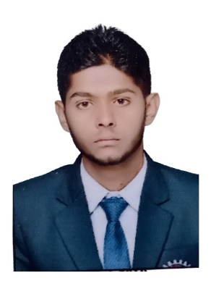


Shaikh Asim
Education and certificates
Analyst/Software Engineer
Base Location: MUMBAI
Bachelor of Engineering & Technology
Mechanical Engg 2015-2019
Skills
Spring Boot
Spring MVC
JPA CRUD/JPA MONGODB
Bootstrap
Backend
Spring Boot/Spring Security
MongoDB
Database
SQL database
MongoDB
Web Technologies
HTML5
CSS3
Javascript/TypeScript
Additional Details
Communication Skill
Leadership
Team management
Email ID:
Shaikh-asim.shaikh-shami@capgemini.com
Mobile No: +919637855254
Grade: A4
Strengths
Full Stack Developer
Good Knowledge of java programming.
Achievement
ONLINE EXAM PORTAL
Case study of Online Exam Portal System along with Spring Boot, HTML5, CSS and React used as User Interface.
•Good with Spring Framework
•Good in developing web pages using HTML, CSS.
•Currently learning on iTransform: Full Stack With React, Spring Boot MS & MongoDB
Full Stack developer with React and Full Stack Java Developer
Four layered architecture which includes a Presentation Layer, Business Layer, Persistence Layer and Database Layer. Exception Layer handled the exceptions.
Hands on experience in developing web pages
using HTML5, CSS3, REACT. Good understanding of Document Object Model (DOM) and DOM Functions.
Proficient in creating Single page Web Application in
REACT with routing.
Presentation Title | Author | Date © Capgemini 2017. All rights reserved | 1

